Slide 1
Uninformed Search
Md Mehrab Hossain Opi
CSE 4109: Artificial Intelligence

Slide 2
Uninformed Search
Strategies that have no additional information about states beyond that provided in the problem definition.
Only know
Problem definition.
How to generate successor.
How to recognize a goal state.
Strategies only differ in the order they expand nodes.

Slide 3
Breadth-First Search
The shallowest unexpanded node is chosen for expansion.
Achieved by using a FIFO queue as frontier.
New nodes go the back; old nodes are expanded first.
General approach is slightly changed.
Goal test is applied during generation of node.
Always finds the shallowest path to any node.

Slide 4
Breadth-First Search
function BREADTH-FIRST-SEARCH(problem) returns a solution, or failure
node ←a node with STATE = problem.INITIAL-STATE,PATH-COST =0
if problem.GOAL-TEST(node.STATE) then return SOLUTION(node)
frontier ←a FIFO queue with node as the only element
explored ←an empty set
loop do
if EMPTY?(frontier) then return failure
node ←POP(frontier) /* chooses the shallowest node in frontier */
add node.STATE to explored
for each action in problem.ACTIONS(node.STATE) do
child ←CHILD-NODE(problem,node,action)
if child.STATE is not in explored or frontier then
if problem.GOAL-TEST(child.STATE) then return SOLUTION(child)
frontier ←INSERT(child,frontier)

Slide 5
BFS Performance
Is it Complete?
Is it Optimal?
Notes:
Only if the path cost is a non-decreasing function of the depth of the node.

Slide 6

BFS Performance
What about time complexity?
We are not talking about $O(V+E)$.
Think about branching factor and depth.

Slide 7
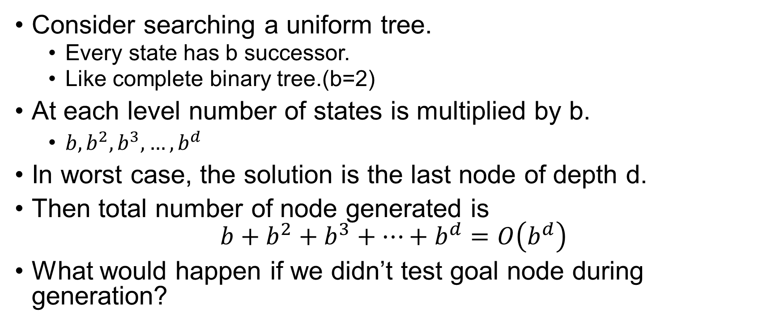
BFS Performance
Consider searching a uniform tree.
Every state has b successor.
Like complete binary tree.(b=2)
At each level number of states is multiplied by b.
$b, b^{2}, b^{3},…, b^{d}$
In worst case, the solution is the last node of depth d.
Then total number of node generated is $b+b^{2}+b^{3}+…+b^{d}=O\left(b^{d}\right)$
What would happen if we didn’t test goal node during generation?

Slide 8

BFS Performance
How about space complexity?
Every node generated remains in the memory.
Either in frontier, or in the explored set.
Hence, $O(b^{d})$.

Slide 9
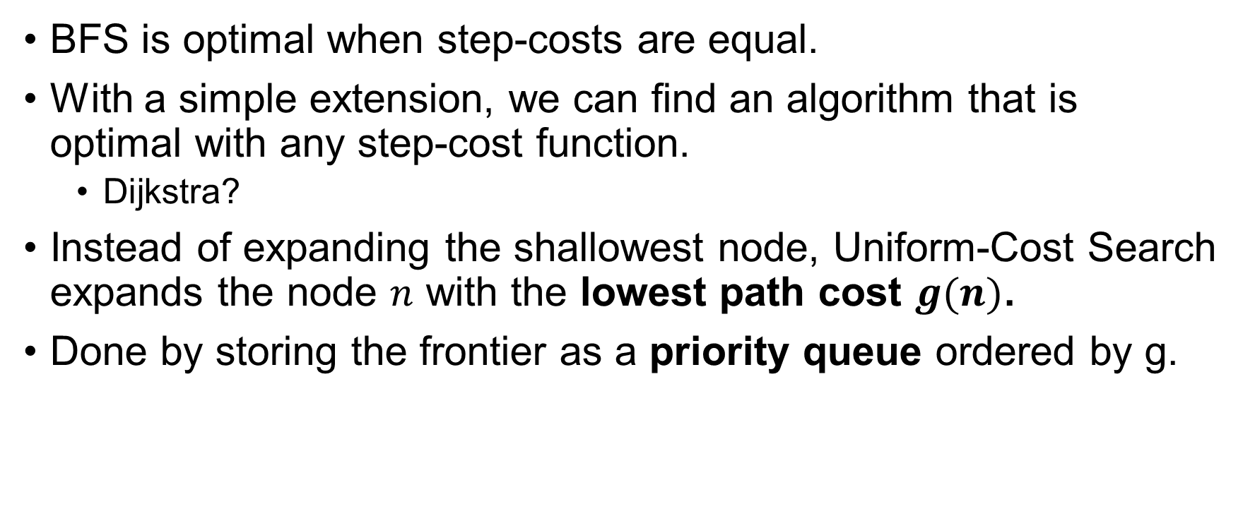
Uniform-cost Search
BFS is optimal when step-costs are equal.
With a simple extension, we can find an algorithm that is optimal with any step-cost function.
Dijkstra?
Instead of expanding the shallowest node, Uniform-Cost Search expands the node $n$ with the lowest path cost $g(n)$.
Done by storing the frontier as a priority queue ordered by g.

Slide 10
Uniform-cost Search
function UNIFORM-COST-SEARCH(problem) returns a solution, or failure
node ←a node with STATE = problem.INITIAL-STATE, PATH-COST =0
frontier ←a priority queue ordered by PATH-COST, with node as the only element
explored ←an empty set
loop do
if EMPTY?(frontier) then return failure
node ←POP(frontier) /* chooses the lowest-cost node in frontier */
if problem.GOAL-TEST(node.STATE) then return SOLUTION(node)
add node.STATE to explored
for each action in problem.ACTIONS(node.STATE) do
child ←CHILD-NODE(problem,node,action)
if child.STATE is not in explored or frontier then
frontier ←INSERT(child,frontier)
else if child.STATE is in frontier with higher PATH-COST then
replace that frontier node with child
Notes:
Goal test is done when selected for expansion, test of better path.

Slide 11
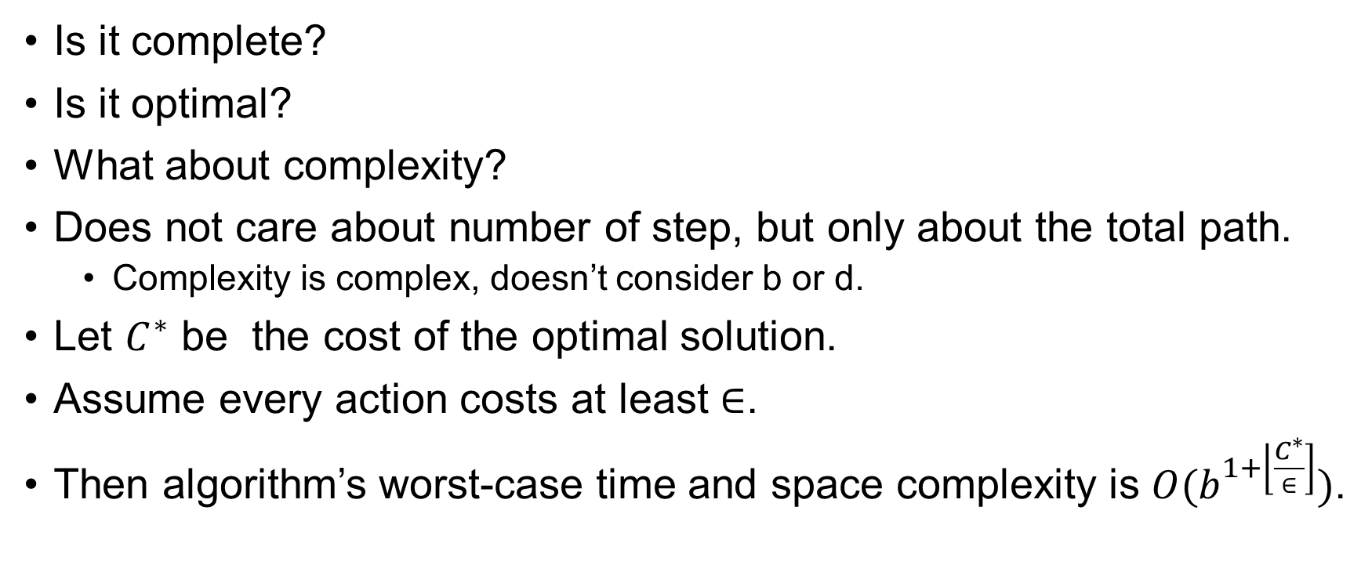
Performance of Uniform-cost Search
Is it complete?
Is it optimal?
What about complexity?
Does not care about number of step, but only about the total path.
Complexity is complex, doesn’t consider b or d.
Let $C^{∗}$ be the cost of the optimal solution.
Assume every action costs at least $∈$.
Then algorithm’s worst-case time and space complexity is $O(b^{1+\left\lfloor \frac{C^{∗}}{∈}\right]})$.

Slide 12
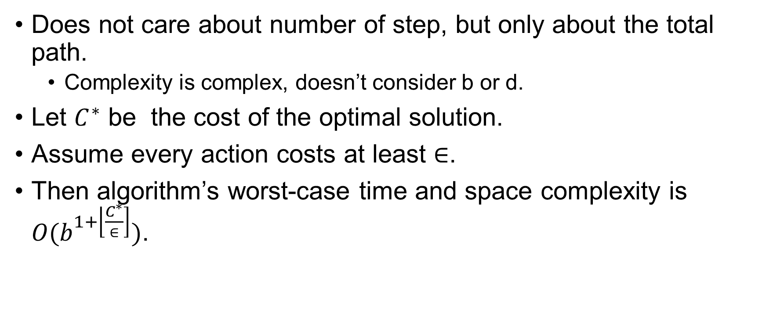
Performance of Uniform-cost Search
Does not care about number of step, but only about the total path.
Complexity is complex, doesn’t consider b or d.
Let $C^{∗}$ be the cost of the optimal solution.
Assume every action costs at least $∈$.
Then algorithm’s worst-case time and space complexity is $O(b^{1+\left\lfloor \frac{C^{∗}}{∈}\right]})$.

Slide 13
Depth-First Search
Expands the deepest node in the current frontier.
Uses a LIFO queue.
Stack.
Most recently generated node is chosen for expansion.
Often implemented in recursive manner.

Slide 14
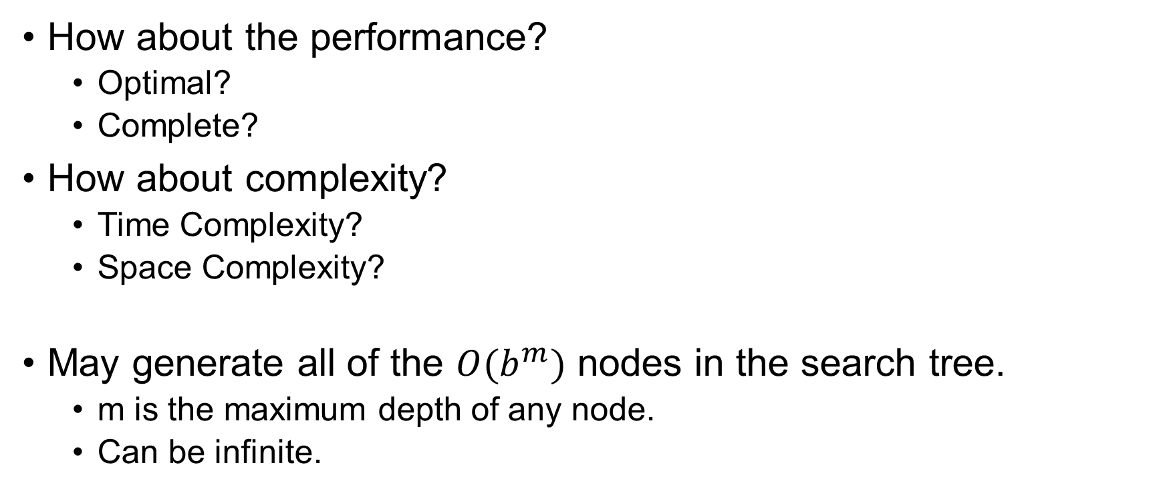
Depth-First Search
How about the performance?
Optimal?
Complete?
How about complexity?
Time Complexity?
Space Complexity?
May generate all of the $O(b^{m})$ nodes in the search tree.
m is the maximum depth of any node.
Can be infinite.

Slide 15
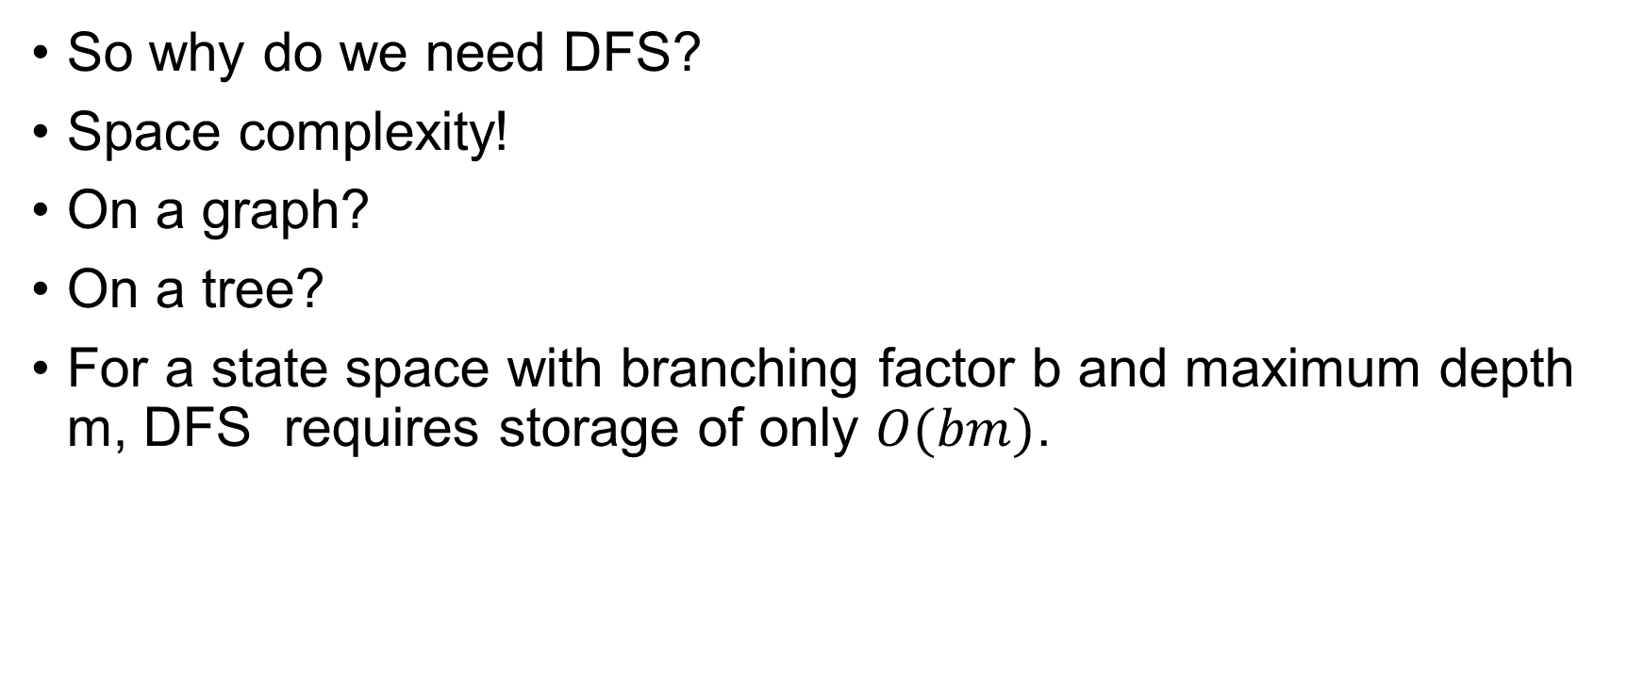
Depth-First Search
So why do we need DFS?
Space complexity!
On a graph?
On a tree?
For a state space with branching factor b and maximum depth m, DFS requires storage of only $O(bm)$.

Slide 16
Depth-Limited Search
DFS fails in infinite state space.
This is solved by depth-limited search.
A predetermined depth limit (l) is selected first.
DFS treats the nodes at level l as leaf.
The successors of level l+1 are ignored.
Is it complete?
Is it optimal?

Slide 17
Depth-Limited Search
function DEPTH-LIMITED-SEARCH(problem,limit) returns a solution, or failure/cutoff
return RECURSIVE-DLS(MAKE-NODE(problem.INITIAL-STATE),problem,limit)
function RECURSIVE-DLS(node,problem,limit) returns a solution, or failure/cutoff
if problem.GOAL-TEST(node.STATE) then return SOLUTION(node)
else if limit =0 then return cutoff
else
cutoff occurred?←false
for each action in problem.ACTIONS(node.STATE) do
child ←CHILD-NODE(problem,node,action)
result ←RECURSIVE-DLS(child,problem,limit − 1)
if result = cutoff then cutoff occurred?←true
else if result= failure then return result
if cutoff occurred? then return cutoff else return failure

Slide 18
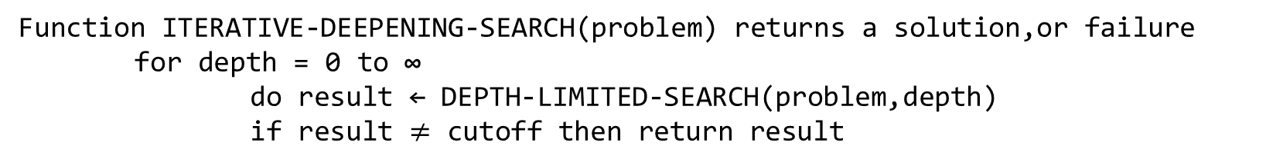
Iterative Deepening DFS
IDS gradually increases the depth limit, until the goal is found.
Function ITERATIVE-DEEPENING-SEARCH(problem) returns a solution,or failure for depth = 0 to ∞
do result ← DEPTH-LIMITED-SEARCH(problem,depth)
if result $≠$ cutoff then return result

Slide 19
Iterative Deepening DFS
Combines the benefit of both BFS and DFS.
Memory complexity?
O(bd)
Complete?
How about time complexity?
Aren’t we generating same node multiple times?

Slide 20
Iterative Deepening DFS
Turns out it’s not that costly.
Most of the nodes are in the bottom level.
How does it compare with BFS?

Slide 21
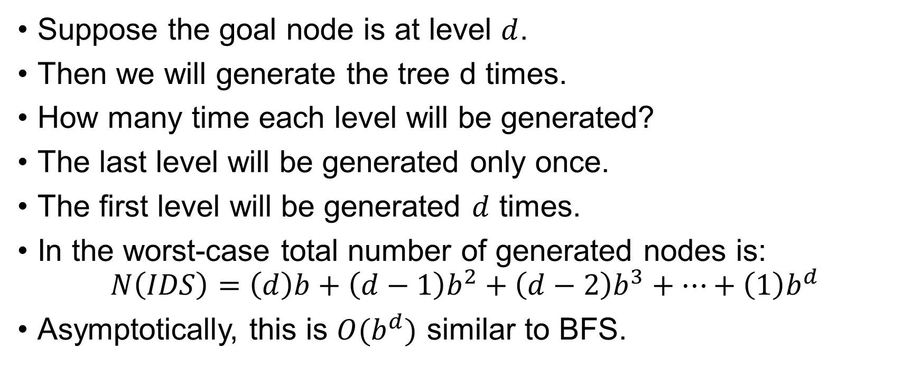
Iterative Deepening DFS
Suppose the goal node is at level $d$.
Then we will generate the tree d times.
How many time each level will be generated?
The last level will be generated only once.
The first level will be generated $d$ times.
In the worst-case total number of generated nodes is:
$$N\left(IDS\right)=\left(d\right)b+\left(d−1\right)b^{2}+\left(d−2\right)b^{3}+…+\left(1\right)b^{d}$$
Asymptotically, this is $O(b^{d})$ similar to BFS.

Slide 22
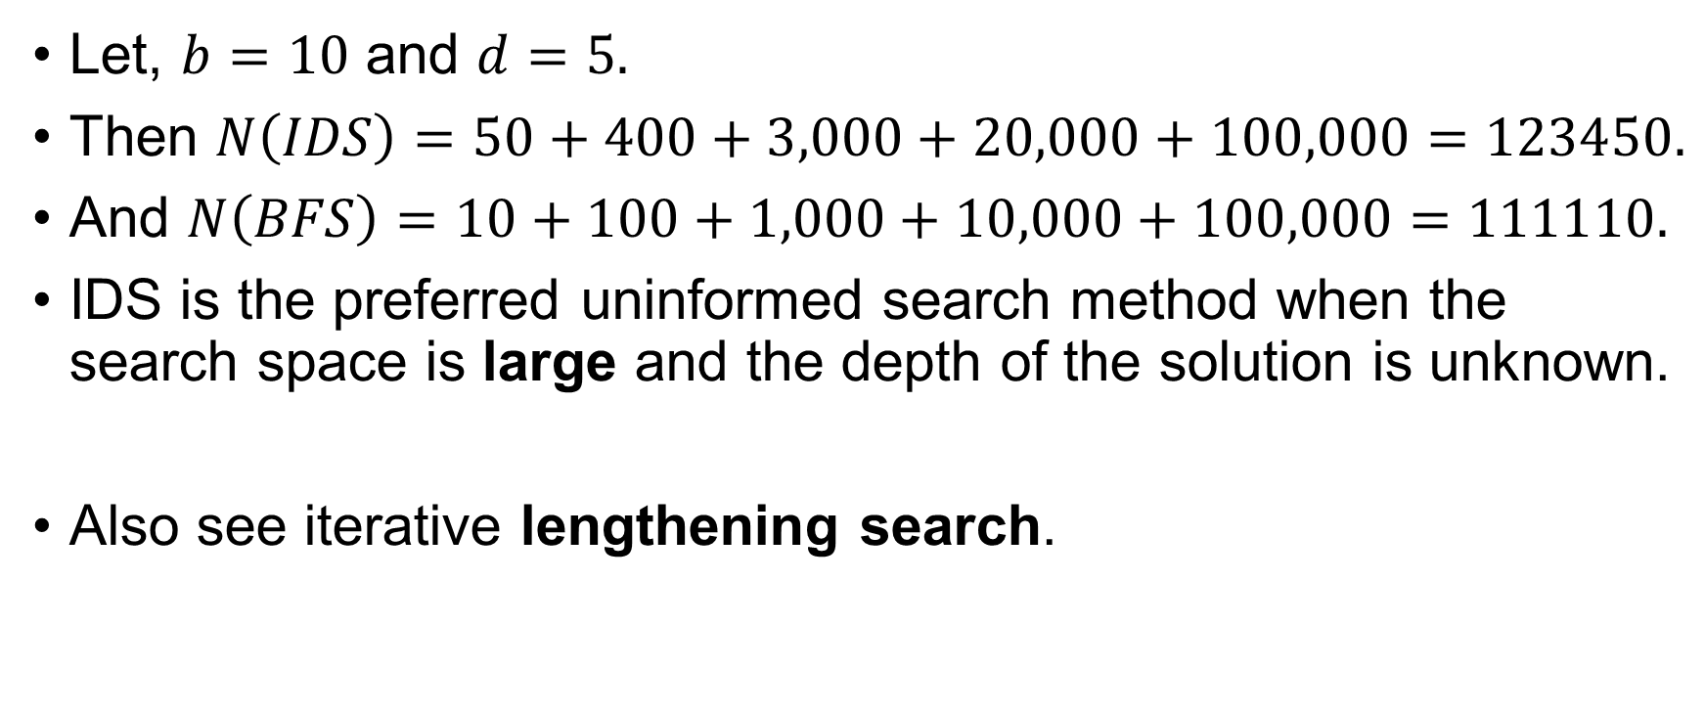
Iterative Deepening DFS
Let, $b=10$ and $d=5.$
Then $N\left(IDS\right)=50+400+3,000+20,000+100,000=123450.$
And $N\left(BFS\right)=10+100+1,000+10,000+100,000=111110.$
IDS is the preferred uninformed search method when the search space is large and the depth of the solution is unknown.
Also see iterative lengthening search.

Slide 23
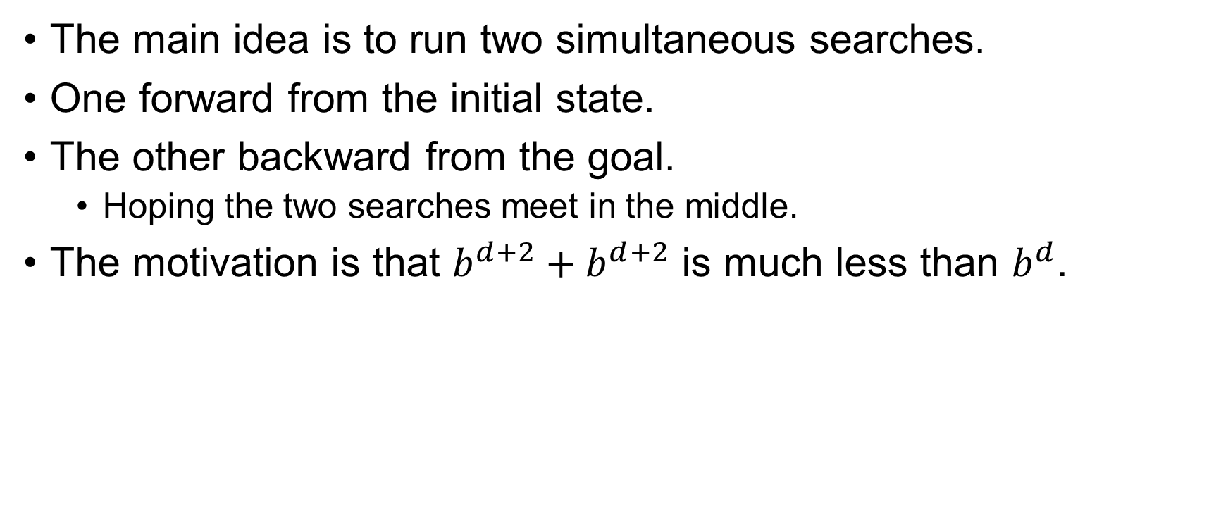
Bidirectional Search
The main idea is to run two simultaneous searches.
One forward from the initial state.
The other backward from the goal.
Hoping the two searches meet in the middle.
The motivation is that $b^{d+2}+b^{d+2}$ is much less than $b^{d}$.

Slide 24
Bidirectional Search
Goal test is replaced with a check to see whether the frontiers of the two searches intersect.
If they do a solution is found.
Now this solution might not be the optimal one.
The check can be done when each node is generated or selected for expansion and, with a hash table, will take constant time.

Slide 25
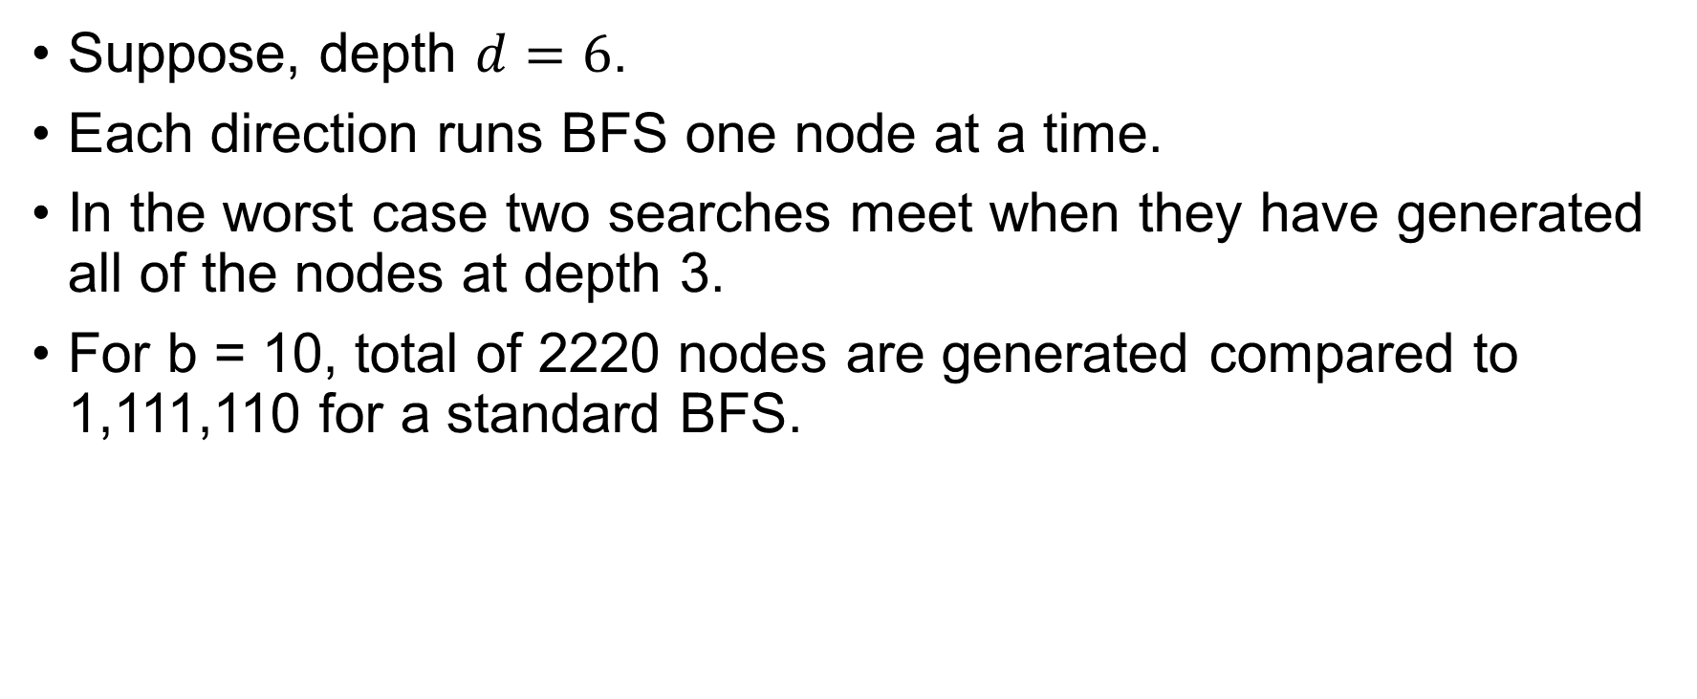
Bidirectional Search
Suppose, depth $d=6$.
Each direction runs BFS one node at a time.
In the worst case two searches meet when they have generated all of the nodes at depth 3.
For b = 10, total of 2220 nodes are generated compared to 1,111,110 for a standard BFS.

Slide 26
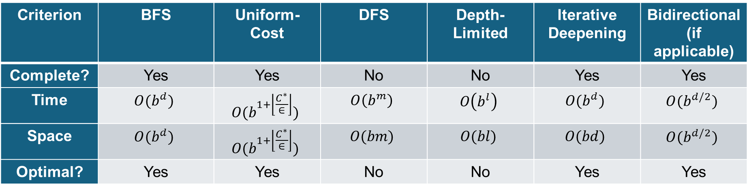
Comparing Uninformed Search
Criterion | BFS | Uniform-Cost | DFS | Depth-Limited | Iterative Deepening | Bidirectional(if applicable)
Complete? | Yes | Yes | No | No | Yes | Yes
Time | $$O(b^{d})$$ | $$O(b^{1+\left\lfloor \frac{C^{∗}}{∈}\right\rfloor })$$ | $$O\left(b^{m}\right)$$ | $$O\left(b^{l}\right)$$ | $$O(b^{d})$$ | $$O(b^{d/2})$$
Space | $$O(b^{d})$$ | $$O(b^{1+\left\lfloor \frac{C^{∗}}{∈}\right\rfloor })$$ | $$O(bm)$$ | $$O(bl)$$ | $$O(bd)$$ | $$O(b^{d/2})$$
Optimal? | Yes | Yes | No | No | Yes | Yes

Slide 27
Thank You.

